Slide 1
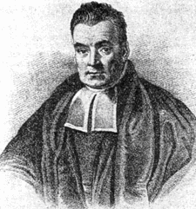
Bayesian
Reasoning
Thomas Bayes, 1701-1761
Adapted from slides by Tim Finin

Slide 2
Today’s topics
Review probability theory
Bayesian inference
  From the joint distribution
  Using independence/factoring
  From sources of evidence
Bayesian Nets

Slide 3
Sources of Uncertainty
Uncertain inputs -- missing and/or noisy data
Uncertain knowledge
  Multiple causes lead to multiple effects
  Incomplete enumeration of conditions or effects
  Incomplete knowledge of causality in the domain
  Probabilistic/stochastic effects
Uncertain outputs
  Abduction and induction are inherently uncertain
  Default reasoning, even deductive, is uncertain
  Incomplete deductive inference may be uncertain
Probabilistic reasoning only gives probabilistic results (summarizes uncertainty from various sources)

Slide 4
Decision making with uncertainty
Rational behavior:
For each possible action, identify the possible outcomes
Compute the probability of each outcome
Compute the utility of each outcome
Compute the probability-weighted (expected) utility over possible outcomes for each action
Select action with the highest expected utility (principle of Maximum Expected Utility)

Slide 5
Why probabilities anyway?
Kolmogorov showed that three simple axioms lead to the rules of probability theory
All probabilities are between 0 and 1:
  0 ≤ P(a) ≤ 1
Valid propositions (tautologies) have probability 1, and unsatisfiable propositions have probability 0:
  P(true) = 1 ; P(false) = 0
The probability of a disjunction is given
by:
  P(a ∨ b) = P(a) + P(b) – P(a ∧ b)
a
a∧b
b

Slide 6
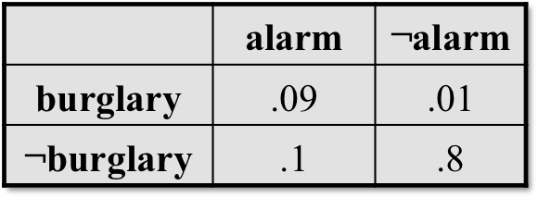
Probability theory 101
Random variables
  Domain
Atomic event: complete specification of state
Prior probability: degree of belief without any other evidence
Joint probability: matrix of combined probabilities of a set of variables
Alarm, Burglary, Earthquake
  Boolean (like these), discrete, continuous
Alarm=T∧Burglary=T∧Earthquake=F
alarm ∧ burglary ∧ ¬earthquake
P(Burglary) = 0.1
P(Alarm) = 0.1
P(earthquake) = 0.000003
P(Alarm, Burglary) =

Slide 7
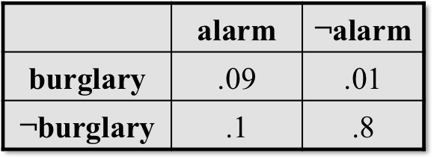
Probability theory
101
Conditional probability: prob. of effect given causes
Computing conditional probs:
  P(a | b) = P(a ∧ b) / P(b)
  P(b): normalizing constant
Product rule:
  P(a ∧ b) = P(a | b) * P(b)
Marginalizing:
  P(B) = Σ_{a}P(B, a)
  P(B) = Σ_{a}P(B | a) P(a) (conditioning)
P(burglary | alarm) = .47
P(alarm | burglary) = .9
P(burglary | alarm) =
P(burglary ∧ alarm) / P(alarm)
= .09/.19 = .47
P(burglary ∧ alarm) =
P(burglary | alarm) * P(alarm)
= .47 * .19 = .09
P(alarm) =
P(alarm ∧ burglary) +
P(alarm ∧ ¬burglary)
= .09+.1 = .19

Slide 8
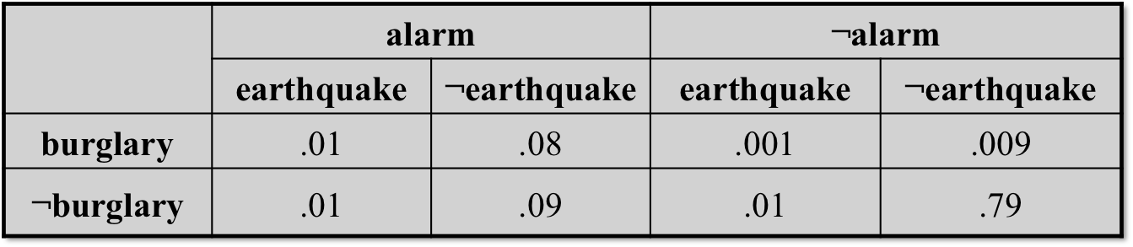
Example: Inference from the joint
P(burglary | alarm) = α P(burglary, alarm)
= α [P(burglary, alarm, earthquake) + P(burglary, alarm, ¬earthquake)
= α [ (.01, .01) + (.08, .09) ]
= α [ (.09, .1) ]
Since P(burglary | alarm) + P(¬burglary | alarm) = 1, α = 1/(.09+.1) = 5.26
(i.e., P(alarm) = 1/α = .19)
P(burglary | alarm) = .09 * 5.26 = .474
P(¬burglary | alarm) = .1 * 5.26 = .526

Slide 9

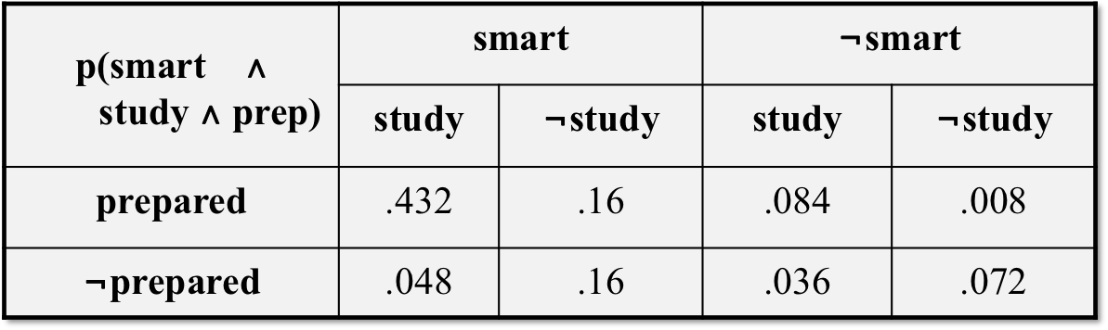
Exercise:
Inference from the joint
Queries:
  What is the prior probability of smart?
  What is the prior probability of study?
  What is the conditional probability of prepared, given study and smart?
  P(prepared,smart,study)/P(smart,study) =
0.8
0.6
0.9
Notes:
p(smart) = .432 + .16 + .048 + .16 = 0.8
p(study) = .432 + .048 + .084 + .036 = 0.6
p(prepared | smart, study) = p(prepared, smart, study) / p(smart, study) = .432 / (.432 + .048) = 0.9

Slide 10

Independence
When sets of variables don’t affect each others’ probabilities, we call them independent, and can easily compute their joint and conditional probability:
  Independent(A, B) → P(A∧B) = P(A) * P(B), P(A | B) = P(A)
{moonPhase, lightLevel} might be independent of {burglary, alarm, earthquake}
  Maybe not: crooks may be more likely to burglarize houses during a new moon (and hence little light)
  But if we know the light level, the moon phase doesn’t affect whether we are burglarized
  If burglarized, light level doesn’t affect if alarm goes off
Need a more complex notion of independence and methods for reasoning about the relationships

Slide 11
Exercise: Independence
Query: Is smart independent of study?
P(smart|study) == P(smart)
P(smart|study) = P(smart ∧study)/P(study)
P(smart|study) = (.432 + .048)/(.432 + .048 + .084 + .036) = .48/.6 = 0.8
P(smart) = .432 + .16 + .048 + .16 = 0.8
INDEPENDENT!
Notes:
Q1 is true iff p(smart | study) == p(smart)
p(smart | study) = p(smart, study) / p(study) = (.432 + .048) / .6 = 0.8
0.8 == 0.8, so smart is independent of study
Q2 is true iff p(prepared | study) == p(prepared)
p(prepared | study) = p(prepared, study) / p(study) = (.432 + .084) / .6 = .86
0.86 =/= 0.8, so prepared is not independent of study

Slide 12
Conditional independence
Absolute independence:
  A and B are independent if P(A ∧ B) = P(A) * P(B); equivalently, P(A) = P(A | B) and P(B) = P(B | A)
A and B are conditionally independent given C if
  P(A ∧ B | C) = P(A | C) * P(B | C)
This lets us decompose the joint distribution:
  P(A ∧ B ∧ C) = P(A | C) * P(B | C) * P(C)
Moon-Phase and Burglary are conditionally independent given Light-Level
Conditional independence is weaker than absolute independence, but still useful in decomposing the full joint probability distribution

Slide 13
Exercise: Conditional independence
Queries:
  Is smart conditionally independent of prepared, given study?
  P(smart ∧prepared | study) == P(smart | study) * P(prepared | study)
  P(smart ∧ prepared | study) = P(smart ∧ prepared ∧ study) / P(study)
  = .432/ (.432 + .048 + .084 + .036) = .432/.6 = .72
  P(smart | study) * P(prepared | study) = .8 * .86 = .688
NOT!
Notes:
Q1 is true iff p(smart, prepared | study) == p(smart | study) * p(prepared | study)
p(smart, prepared | study) = p(smart, prepared) / p(study) = (.432 + .16) / .6 = .987
p(smart | study) * p(prepared | study) = .8 * .86 = .688
No, smart is not conditionally independent of prepared, given study
Q2 is true iff …

Slide 14
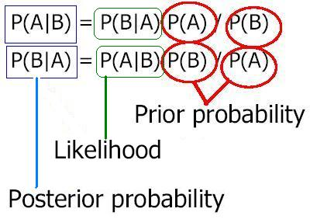
Bayes’ rule
Derived from the product rule:
  P(C | E) = P(E | C) * P(C) / P(E)
Often useful for diagnosis:
  If E are (observed) effects and C are (hidden) causes,
  We may have a model for how causes lead to effects (P(E | C))
  We may also have prior beliefs (based on experience) about the frequency of occurrence of effects (P(C))
  Which allows us to reason abductively from effects to causes (P(C | E))

Slide 15
Ex: meningitis and stiff neck
Meningitis (M) can cause a a stiff neck (S), though there are many other causes for S, too
We’d like to use S as a diagnostic symptom and estimate p(M|S)
Studies can easily estimate p(M), p(S) and p(S|M)
p(S|M)=0.7, p(S)=0.01, p(M)=0.00002
Applying Bayes’ Rule:
p(M|S) = p(S|M) * p(M) / p(S) = 0.0014

Slide 16
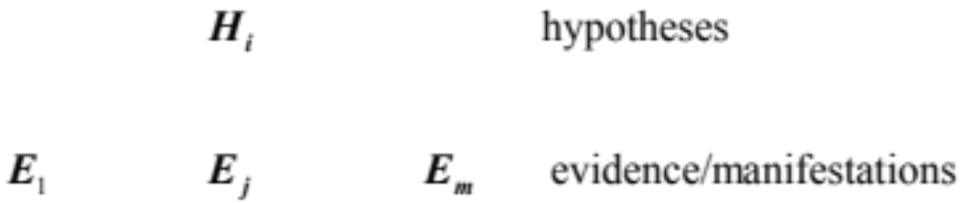





Bayesian inference
In the setting of diagnostic/evidential reasoning
  Know prior probability of hypothesis
  conditional probability
  Want to compute the posterior probability
Bayes’s theorem (formula 1):

Slide 17
Simple Bayesian diagnostic reasoning
Also known as: Naive Bayes classifier
Knowledge base:
  Evidence / manifestations: E₁, … E_{m}
  Hypotheses / disorders: H₁, … H_{n}
    Note: E_{j} and H_{i} are binary; hypotheses are mutually exclusive (non-overlapping) and exhaustive (cover all possible cases)
  Conditional probabilities: P(E_{j} | H_{i}), i = 1, … n; j = 1, … m
Cases (evidence for a particular instance): E₁, …, E_{l}
Goal: Find the hypothesis H_{i} with the highest posterior
  Max_{i} P(H_{i} | E₁, …, E_{l})

Slide 18
Simple Bayesian diagnostic reasoning
Bayes’ rule says that
  P(H_{i} | E₁… E_{m}) = P(E₁…E_{m} | H_{i}) P(H_{i}) / P(E₁… E_{m})
Assume each evidence E_{i} is conditionally indepen-dent of the others, given a hypothesis H_{i}, then:
  P(E₁…E_{m} | H_{i}) = ∏^{m}_{j=1} P(E_{j} | H_{i})
If we only care about relative probabilities for the H_{i}, then we have:
  P(H_{i} | E₁…E_{m}) = α P(H_{i}) ∏^{m}_{j=1} P(E_{j} | H_{i})

Slide 19
Limitations
Cannot easily handle multi-fault situations, nor
cases where intermediate (hidden) causes exist:
  Disease D causes syndrome S, which causes correlated manifestations M₁ and M₂
Consider a composite hypothesis H₁∧H₂, where H₁ and H₂ are independent. What’s the relative posterior?
  P(H₁ ∧ H₂ | E₁, …, E_{l}) = α P(E₁, …, E_{l} | H₁ ∧ H₂) P(H₁ ∧ H₂)
  = α P(E₁, …, E_{l} | H₁ ∧ H₂) P(H₁) P(H₂)
  = α ∏^{l}_{j=1} P(E_{j} | H₁ ∧ H₂) P(H₁) P(H₂)
How do we compute P(E_{j} | H₁∧H₂) ?

Slide 20
Limitations
Assume H1 and H2 are independent, given E1, …, El?
  P(H₁ ∧ H₂ | E₁, …, E_{l}) = P(H₁ | E₁, …, E_{l}) P(H₂ | E₁, …, E_{l})
This is a very unreasonable assumption
  Earthquake and Burglar are independent, but not given Alarm:
    P(burglar | alarm, earthquake) << P(burglar | alarm)
Another limitation is that simple application of Bayes’s rule doesn’t allow us to handle causal chaining:
  A: this year’s weather; B: cotton production; C: next year’s cotton price
  A influences C indirectly: A→ B → C
  P(C | B, A) = P(C | B)
Need a richer representation to model interacting hypotheses, conditional independence, and causal chaining
Next: conditional independence and Bayesian networks!

Slide 21
Summary
Probability is a rigorous formalism for uncertain knowledge
Joint probability distribution specifies probability of every atomic event
Can answer queries by summing over atomic events
But we must find a way to reduce the joint size for non-trivial domains
Bayes’ rule lets unknown probabilities be computed from known conditional probabilities, usually in the causal direction
Independence and conditional independence provide the tools

Slide 22
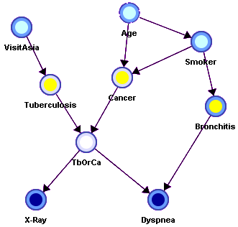
Reasoning with Bayesian
Belief Networks

Slide 23
Overview
Bayesian Belief Networks (BBNs) can reason with networks of propositions and associated probabilities
Useful for many AI problems
  Diagnosis
  Expert systems
  Planning
  Learning

Slide 24
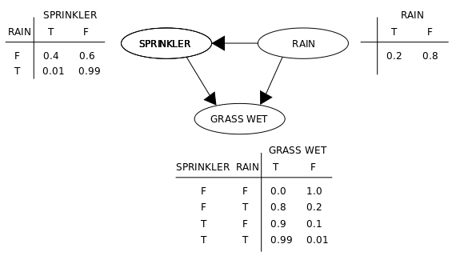
BBN Definition
AKA Bayesian Network, Bayes Net
A graphical model (as a DAG) of probabilistic relationships among a set of random variables
Links represent direct influence of one variable on another
source

Slide 25
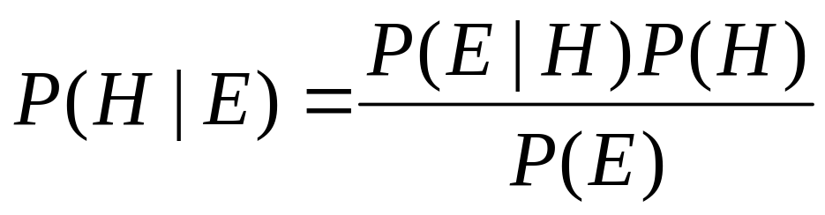
Recall Bayes Rule
Note the symmetry: we can compute the probability of a hypothesis given its evidence and vice versa.

Slide 26
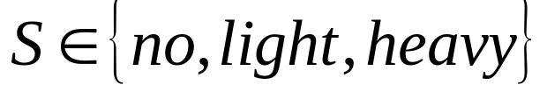
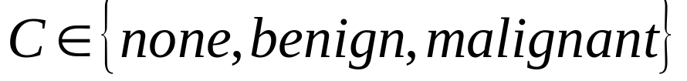
Simple Bayesian Network
Smoking
Cancer
P(
S=no)
0.80
P(
S=light)
0.15
P(
S=heavy)
0.05
Smoking=
no
light
heavy
P(
C=none)
0.96
0.88
0.60
P(
C=benign)
0.03
0.08
0.25
P(
C=malig)
0.01
0.04
0.15

Slide 27
More Complex Bayesian Network
Age
Gender
Exposure
to Toxics
Smoking
Cancer
Serum
Calcium
Lung
Tumor

Slide 28
More Complex Bayesian Network
Nodes
represent
variables
Age
Gender
Exposure
to Toxics
Smoking
Links represent
“causal” relations
Cancer
Does gender cause smoking?
Influence might be a more appropriate term
Serum
Calcium
Lung
Tumor

Slide 29
More Complex Bayesian Network
predispositions
Age
Gender
Exposure
to Toxics
Smoking
Cancer
Serum
Calcium
Lung
Tumor

Slide 30
More Complex Bayesian Network
Age
Gender
Exposure
to Toxics
Smoking
condition
Cancer
Serum
Calcium
Lung
Tumor

Slide 31
More Complex Bayesian Network
Age
Gender
Exposure
to Toxics
Smoking
Cancer
observable symptoms
Serum
Calcium
Lung
Tumor

Slide 32
Independence
Age and Gender are
independent.
Age
Gender
P(A,G) = P(G) P(A)
P(A |G) = P(A)
P(G |A) = P(G)
P(A,G) = P(G|A) P(A) = P(G)P(A)
P(A,G) = P(A|G) P(G) = P(A)P(G)

Slide 33
Conditional Independence
Cancer is independent of Age and Gender given Smoking
Age
Gender
Smoking
P(C | A,G,S) = P(C|S)
Cancer

Slide 34
Conditional Independence: Naïve Bayes
Serum Calcium and Lung Tumor are dependent
Cancer
Serum Calcium is independent of Lung Tumor, given Cancer
Serum
Calcium
Lung
Tumor
P(L | SC,C) = P(L|C)
P(SC | L,C) = P(SC|C)
Naïve Bayes assumption: evidence (e.g., symptoms) is indepen-dent given the disease. This makes it easy to combine evidence

Slide 35
Explaining Away
Exposure to Toxics and Smoking are independent
Exposure
to Toxics
Smoking
Exposure to Toxics is dependent on Smoking, given Cancer
Cancer
P(E=heavy|C=malignant) > P(E=heavy|C=malignant, S=heavy)
Explaining away: reasoning pattern where confirmation of one cause of an event reduces need to invoke alternatives
Essence of Occam’s Razor

Slide 36
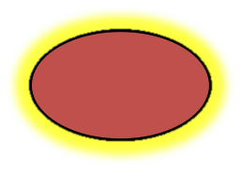
Conditional Independence
A variable (node) is conditionally independent of its non-descendants given its parents
Age
Gender
Non-Descendants
Exposure
to Toxics
Smoking
Parents
Cancer is independent of Age and Gender given Exposure to Toxics and Smoking.
Cancer
Serum
Calcium
Lung
Tumor
Descendants

Slide 37
Another non-descendant
A variable is conditionally independent of its non-descendants given its parents
Age
Gender
Exposure
to Toxics
Smoking
Diet
Cancer
Cancer is independent of Diet given Exposure to Toxics and Smoking
Serum
Calcium
Lung
Tumor

Slide 38
BBN Construction
The knowledge acquisition process for a BBN involves three steps
  Choosing appropriate variables
  Deciding on the network structure
  Obtaining data for the conditional probability tables

Slide 39
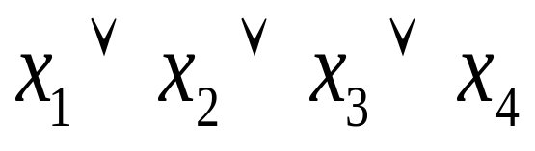
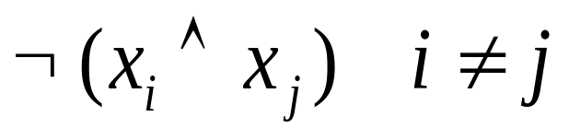
KA1: Choosing variables
Variables should be collectively exhaustive, mutually exclusive values
Error Occurred
No Error
They should be values, not probabilities
Risk of Smoking
Smoking

Slide 40
Heuristic: Knowable in Principle
Example of good variables
  Weather {Sunny, Cloudy, Rain, Snow}
  Gasoline: Cents per gallon
  Temperature { ≥ 100F , < 100F}
  User needs help on Excel Charting {Yes, No}
  User’s personality {dominant, submissive}

Slide 41
KA2: Structuring
Age
Gender
Network structure corresponding
to “causality” is usually good.
Exposure
to Toxic
Smoking
Cancer
Genetic
Damage
Initially this uses the designer’s
knowledge but can be checked with data
Lung
Tumor

Slide 42
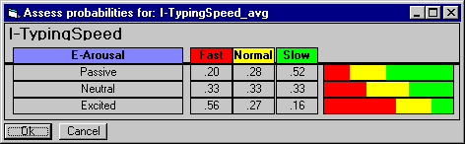
KA3: The numbers
Second decimal usually doesn’t matter
Relative probabilities are important
Zeros and ones are often enough
Order of magnitude is typical: 10⁻⁹ vs 10⁻⁶
Sensitivity analysis can be used to decide accuracy needed

Slide 43
Three kinds of reasoning
BBNs support three main kinds of reasoning:
Predicting conditions given predispositions
Diagnosing conditions given symptoms (and predisposing)
Explaining a condition in by one or more predispositions
To which we can add a fourth:
Deciding on an action based on the probabilities of the conditions

Slide 44
Predictive Inference
Age
Gender
How likely are elderly males
to get malignant cancer?
Exposure
to Toxics
Smoking
Cancer
P(C=malignant | Age>60, Gender=male)
Serum
Calcium
Lung
Tumor

Slide 45
Predictive and diagnostic combined
Age
Gender
How likely is an elderly male patient with high Serum Calcium to have malignant cancer?
Exposure
to Toxics
Smoking
Cancer
P(C=malignant | Age>60,
Gender= male, Serum Calcium = high)
Serum
Calcium
Lung
Tumor

Slide 46
Explaining away
Age
Gender
If we see a lung tumor, the probability of heavy smoking and of exposure to toxics both go up.
Exposure
to Toxics
Smoking
Smoking
Cancer
If we then observe heavy smoking, the probability of exposure to toxics goes back down.
Serum
Calcium
Lung
Tumor

Slide 47
Decision making
Decision - an irrevocable allocation of domain resources
Decision should be made so as to maximize expected utility.
View decision making in terms of
  Beliefs/Uncertainties
  Alternatives/Decisions
  Objectives/Utilities

Slide 48

A Decision Problem
Should I have my party inside
or outside?
dry
Regret
in
wet
Relieved
dry
Perfect!
out
wet
Disaster

Slide 49
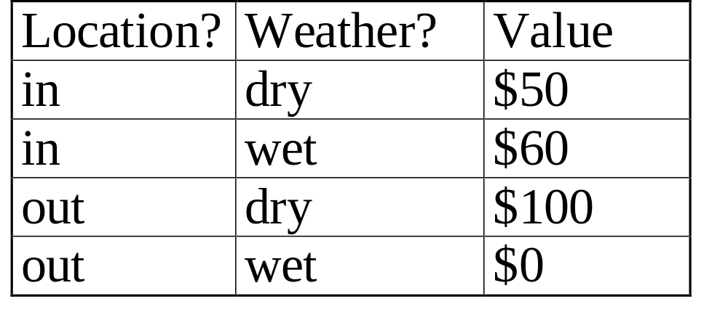
Value Function
A numerical score over all possible states of the world allows BBN to be used to make decisions

Slide 50
Two software tools
Netica: Windows app for working with Bayes-ian belief networks and influence diagrams
  A commercial product but free for small networks
  Includes a graphical editor, compiler, inference engine, etc.
Samiam: Java system for modeling and reasoning with Bayesian networks
  Includes a GUI and reasoning engine

Slide 51
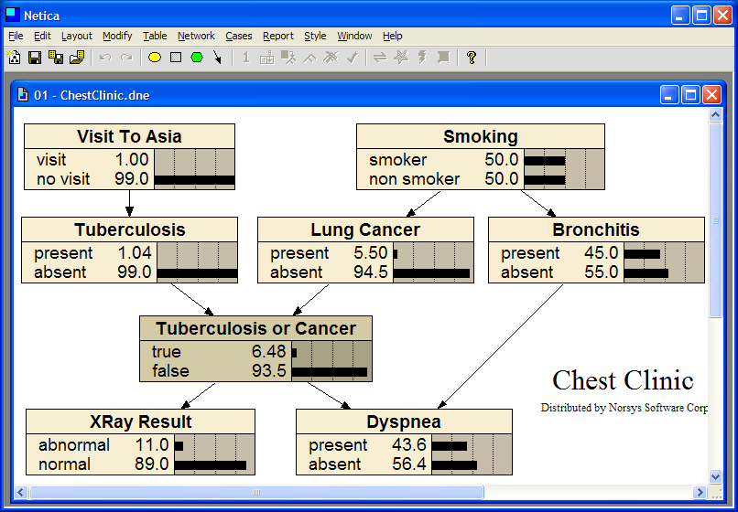

Slide 52
Predispositions or causes

Slide 53
Conditions or diseases

Slide 54
Functional Node

Slide 55
Symptoms or effects
Dyspnea is shortness of breath

Slide 56
Decision Making with BBNs
Today’s weather forecast might be either sunny, cloudy or rainy
Should you take an umbrella when you leave?
Your decision depends only on the forecast
  The forecast “depends on” the actual weather
Your satisfaction depends on your decision and the weather
  Assign a utility to each of four situations: (rain|no rain) x (umbrella, no umbrella)

Slide 57
Decision Making with BBNs
Extend the BBN framework to include two new kinds of nodes: Decision and Utility
A Decision node computes the expected utility of a decision given its parent(s), e.g., forecast, an a valuation
A Utility node computes a utility value given its parents, e.g. a decision and weather
    We can assign a utility to each of four situations: (rain|no rain) x (umbrella, no umbrella)
    The value assigned to each is probably subjective

Slide 58
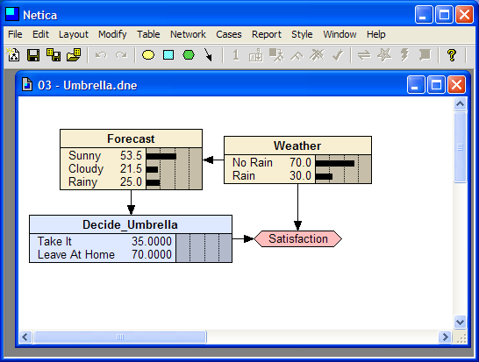

Slide 59
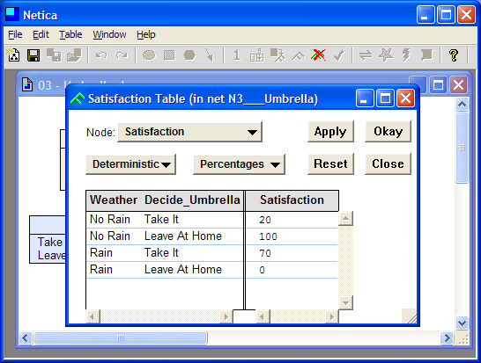

Slide 60
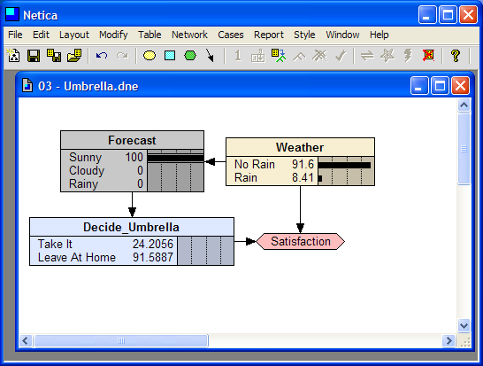

Slide 61
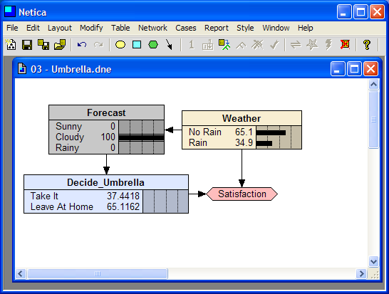

Slide 62
